Slide 1
GAR
Course Intro
Notes:
Welcome to Game Architecture. First the course: who we are, what you’ll build, how you’re assessed. Then Pong.

Slide 2

Who am I?
Jakob Trigger Knop
Cand.Scient. Comp. Science
E-mail: jknr@via.dk
Office: C03.01 (Horsens💀)
Notes:
A short introduction: background, what I work on, how to reach me. Keep it to a minute.

Slide 3

Who Are You?
Notes:
Go round the room: name, study line, a game you’ve played a lot, and whether you’ve made a game before.
Note who has made games before; they make good group anchors.

Slide 4
Your Expectations?
Notes:
Ask: what do you hope to get out of this course? Write answers on the board and keep them for the last session.

Slide 5
My Expectations
Engaged students
who build cool stuff
and learn at the same time
Notes:
Say: build a lot, and learn from what you build. Come to class, do the exercises, and bring your project along.

Slide 6
Course Purpose
“The course introduces the student to engine-level game programming using a low-level game framework. The student learns by implementing classic video games, gaining direct control over essential systems like game loop, rendering, asset pipeline and game physics. The purpose is to teach software engineering in a game context, including architecture, design patterns, decoupling, component systems and data-driven design.”
Detailed course description on itslearning
Notes:
The official course description. Underline the last sentence: it’s a software engineering course, in a game context.
Games are the vehicle; architecture and patterns are the subject.

Slide 7
Course Topics
Game Architecture
Software Design Principles
Design Patterns
  State, Observer, Command, Component, Singleton, Service Locator, Prototype, Object Pool, etc..
Game Loop & Rendering
Input Handling
Asset Pipeline
Collision Detection
Game Physics
Tilemaps
Serialization
Data-Driven Design
Optimization
Notes:
Each session has one main topic and a few patterns that go with it. The schedule lists both.
All of it is on the course site; the recap page connects them at the end.

Slide 8
The Games
Pong
Flappy Bird
Snake
Sokoban
Pac-Man
Super Mario Bros
The Legend of Zelda
Angry Birds
Plants vs. Zombies
Pokemon
Geometry Wars
Vampire Survivors
Notes:
One classic game per session, in this order. Each game is small, but introduces one main idea.
The schedule on the site lists each session’s topics.

Slide 9
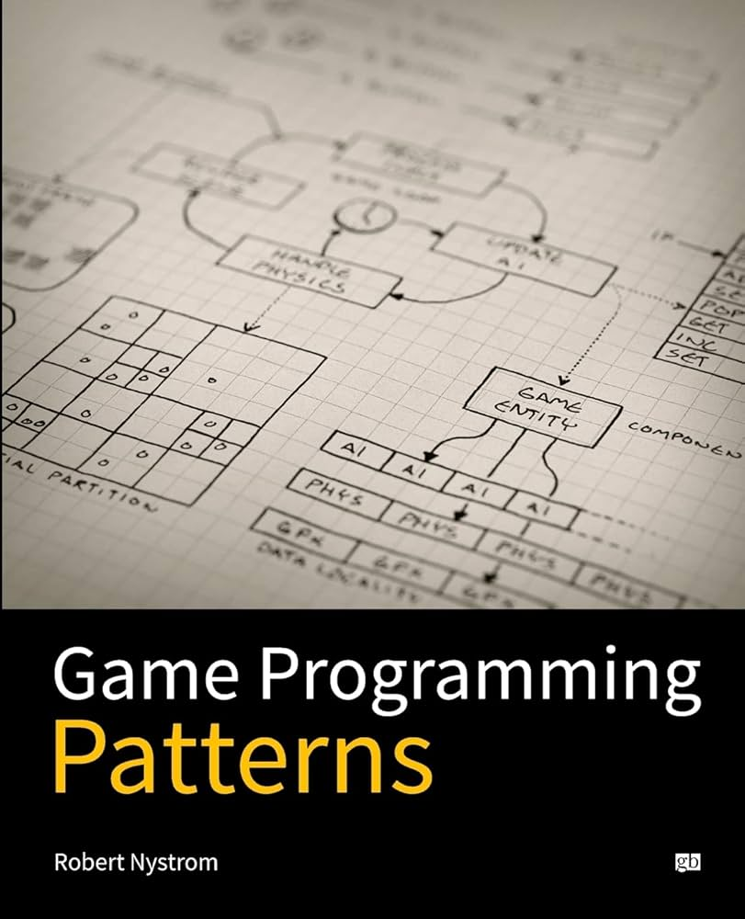
gameprogrammingpatterns.com
Notes:
Game Programming Patterns by Robert Nystrom, free at gameprogrammingpatterns.com. The main reading for the course.
The site links the relevant chapter under Prepare for each session.

Slide 10
How a Session Runs
One classic game, one main topic
Short demos, each followed by a try-it in pairs
Exercises at the end, from the course site
The site has every topic in full: no need to copy slides
Notes:
Every session has the same rhythm: a short demo of one step, then a few minutes in pairs on it, and again.
The exercises at the end are on the site, with full instructions.

Slide 11
Course Project
Build a small 2D game, in a group of 1–3
Organized with the course’s patterns and principles
Start from the gar-starter template
The requirements and milestones: the project page on the course site
Notes:
Groups of 1 to 3 make a small 2D game of their own, using the course’s patterns.
Show the project page on the site. Dates and hand-ins come through itslearning.

Slide 12
Exam
Oral exam, 20 minutes: draw a question from a known pool.
Answer it with your own project: read, explain and change its code.
Draw a question
Explain the idea
Show it in your project
Change the code live
The question pool is on the course site.
Notes:
Walk through the flow on the slide. The question pool is on the site.
Say: your project is your exam material. Every session, ask where the day’s topic fits in your game.

Slide 13
Where Things Are
The course site: sessions, schedule, project and exam
gar-games: the code for every game, one step per concept
gar-starter: the template for your project
Game Programming Patterns: the book, free online
Notes:
Open the site and show the schedule, the project page and the exam page. Then gar-games and the starter template.
Then Pong.

